Slide 1
Solar Farms Forecasting AWS Machine Learning Workshop
Anant, Jon, Kartik, Sandy and Sri
October 29 to 31 at Northwestern University

Slide 2
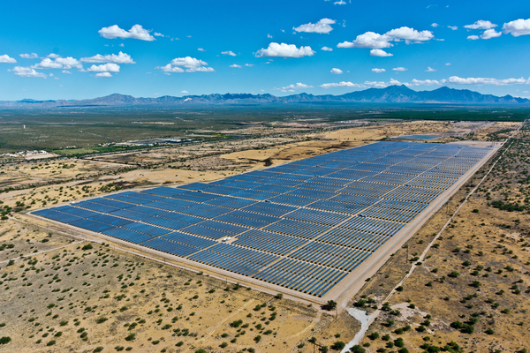
Solar Farms Prediction
Project Goal
ETL Strategy & the Data
Modeling Strategy
Goal for going into Production
Lessons Learned

Slide 3
Project Goal
Predict accurately (85%+) solar energy production in the short term for Oklahoma-based Solar Farms
Compare our SageMaker model (in DeepARPredictor) against the fully-managed forecasting model (Forecast)
Why do it?
By accurately predicting short-term solar energy output to avoid fossil fuel and utility plants cost to meet demand
To utilize a deep learning model (Recurrent Neural Network) for forecasting
To learn modeling in AWS from a beginning to end fashion for reinforced learning
To demonstrate machine learning benefits as compared to humans in forecasting

Slide 4
ETL Strategy and the Data
Solar energy production depends on various environmental factors such as:
Latitude of the farm
Elevaton
Cloud cover and other Weather conditions
Presence of aerosol and pollution
Time of day
Time of year
Past Actuals of Solar Energy by Site by day and time of day
…
Sources: EnergyX, American Meteorological Society (AMS), Weather prediction data comes from the NOAA/ESRL Global Ensemble Forecast System (GEFS) or netCDF files.
Used data: The solar energy was directly measured by a pyranometer at each Mesonet site every 5 minutes and summed from sunrise to 23:55 UTC of the date listed for all 98 sites over multiple years and days
RUL-FD001.text:
112 98 69 82 91 93 91 95 111 96 97 124 95 107 83 84 50 28 87 16 57 111 113 20 145 119 66 97 90 115 8 48 106 7 11 19 21 50 142 28 18 10 59 109 114 47 135 92 21 79 114 29 26 97 137 15 103 37 114 100 21 54 72 28 128 14 77 8 121 94 118 50 131 126 113 10 34 107 63 90 8 9 137 58 118 89 116 115 136 28 38 20 85 55 128 137 82 59 117 20

Slide 5
Model Input Data
5 rows × 99 columns

Slide 6
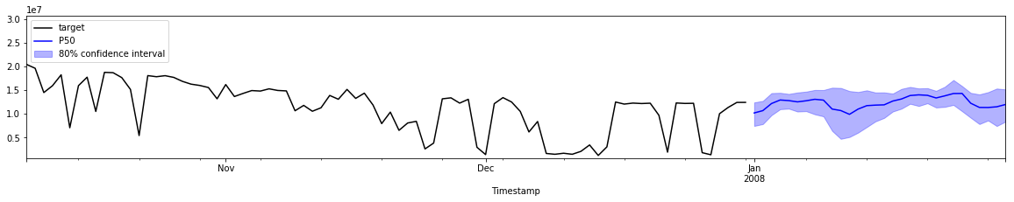
Modeling Strategy
 | ACME
Timestamp
2005-11-25 | 7437900
2005-11-26 | 8199600
2005-11-27 | 10694400
2005-11-28 | 8704800
2005-11-29 | 12803100
Used Recurrent Neural Network deep leaning model
Predicting best fit of solar energy by day
Data split 70% Training to 30% Test / Validation
Other options considered:
Forecast (AWS full feature forecasting model)
Linear and multi-variate regression analysis

Slide 7
Goal for going into Production
Use our model (DeepAR) as is or ….
Use a pre-determined optimizer (Bayesian) to determine best RMSE via hyperparameters
Using hyperparameters:
Epochs
Prediction length
Context length
Learning rate
Likelihood
Gaussian
Student-T
Improved DeepAR model by __% RMSE
Understood modeling requirements with more data types (i.e. weather, pollution, seasonality,…)
Maybe use principal component analysis (PCA) to perform the feature selection engineering or
Use AWS Forecast with its built-in capabilities for feature selection and analysis
Cross-verification with AWS Forecast service
“Production Readiness” considerations for model use
i.e. data collection by day automatically from all Solar Farm sites and monthly model updates including hyperparameters analysis
Compare in production the use of our model versus the current EnergyX method

Slide 8
Lessons Learned
We didn’t get as far as we expected but progressed
Exercising model have gained know-how but model selection is a bit vague
Domain knowledge would be very helpful
Struggled with model’s valid data framework parameters
Comparing SageMaker to other modeling environments
Finding things and confidence

Slide 9
Individual Questions to Answer to Emily
At work, I think I can use _____ to ____
We want to see AWS do __________

